Slide 1
Chapter 3 Process Description and Control
Operating Systems

Slide 2
Agenda
3.1 What is a Process
3.2 Process States
3.3 Process Description
3.4 Process Control
3.5 Summary

Slide 3
Process
A program in execution
An instance of a program running on a computer
The entity that can be assigned to and executed on a processor
A unit of activity characterized by：
  the execution of a sequence of instructions
  a current state
  an associated set of system resources
Notes:
能分配给处理器，并由处理器执行的实体。
具有以下特征的活动单元:一组指令序列的执行、一个当前状态和相关的系统资源集。

Slide 4
Process Control Block(进程控制块)
Contains the process elements
Created and manage by the operating system
Allows support for multiple processes

Slide 5
Process Elements
Identifier
State
Priority
Program counter
Memory pointers
Context data
I/O status information
Accounting information
Notes:
Context data上下文数据:进程执行时处理器的寄存器中的数据。
State :运行、阻塞
记账信息（accounting information）：包括CPU数量和实时使用量、时间限制、账户数目、作业或进程数目等等。

Slide 6
Agenda
3.1 What is a Process
3.2 Process States
3.3 Process Description
3.4 Process Control
3.5 Summary

Slide 7
3.2 Process States
3.2.1 Trace of the Process
3.2.2 A Two-State Process Model
3.2.3 The Creation and Termination of Processes
3.2.4 A Five-State Model
3.2.5 Suspended Process

Slide 8
Trace of Process(进程轨迹)
Sequence of instruction that execute for a process
Dispatcher(调度器) switches the processor from one process to another

Slide 9
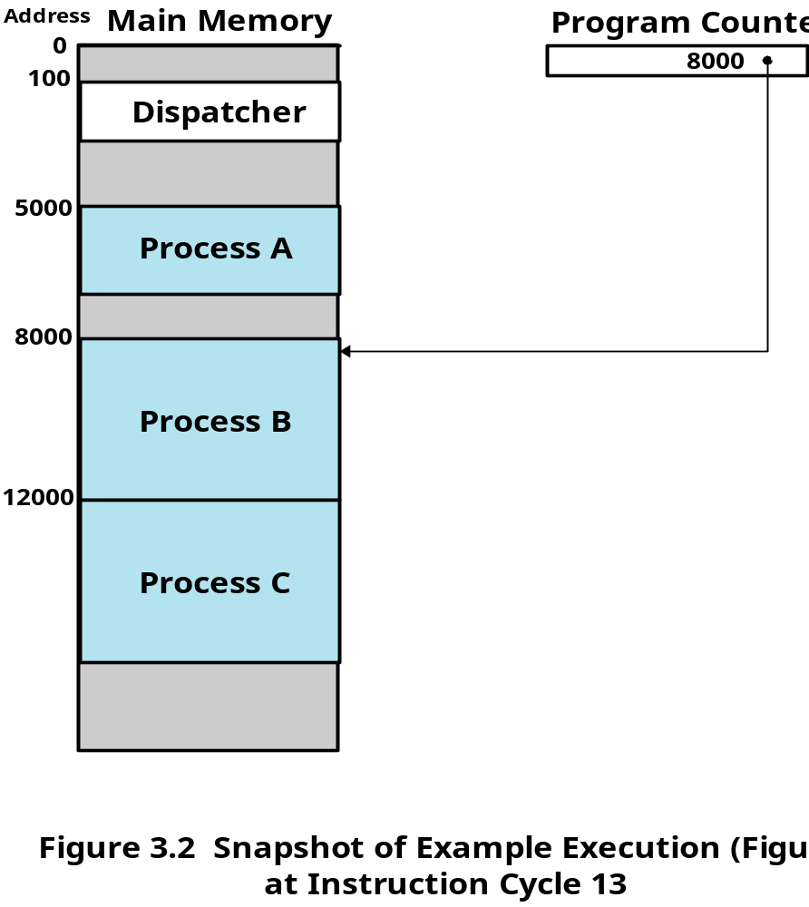
Example Execution

Slide 10
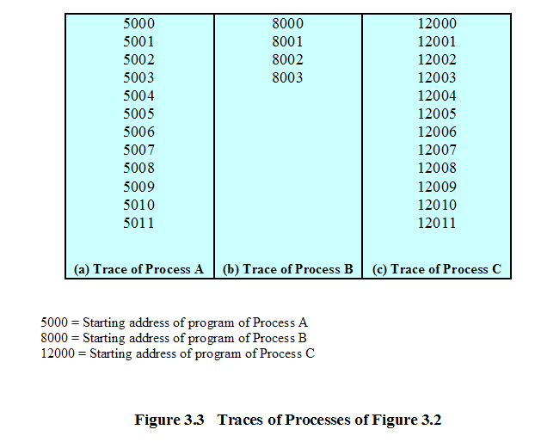
Trace of Processes

Slide 11
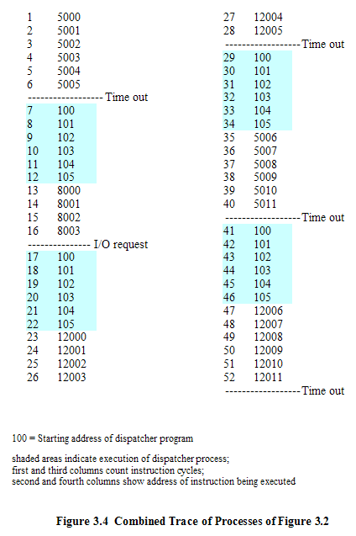
Trace of Processes

Slide 12
3.2 Process States
3.2.1 Trace of the Process
3.2.2 A Two-State Process Model
3.2.3 The Creation and Termination of Processes
3.2.4 A Five-State Model
3.2.5 Suspended Process

Slide 13
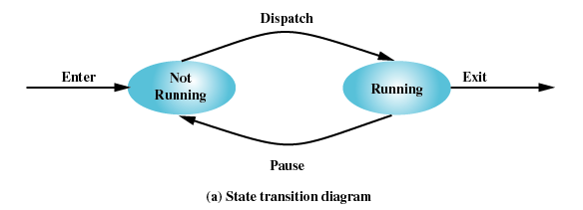
Two-State Process Model
Process may be in one of two states
  Running
  Not-running

Slide 14
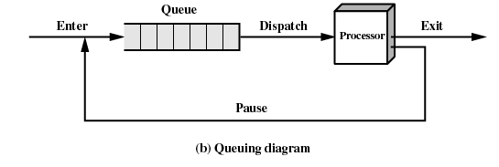
Not-Running Process in a Queue

Slide 15
3.2 Process States
3.2.1 Trace of the Process
3.2.2 A Two-State Process Model
3.2.3 The Creation and Termination of Processes
3.2.4 A Five-State Model
3.2.5 Suspended Process

Slide 16
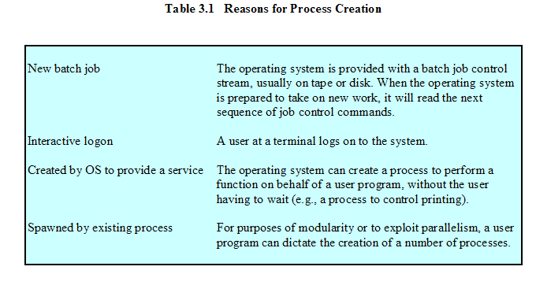
Process Creation
Notes:
Spawned派生；
parallelism并行性
Behalf of 代表 dictate 命令

Slide 17
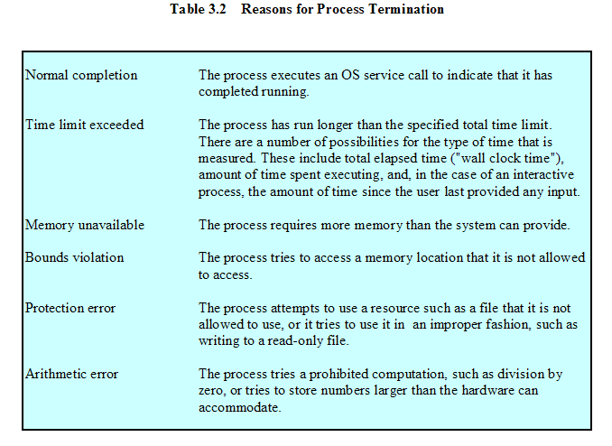
Process Termination
Notes:
挂钟方法

Slide 18
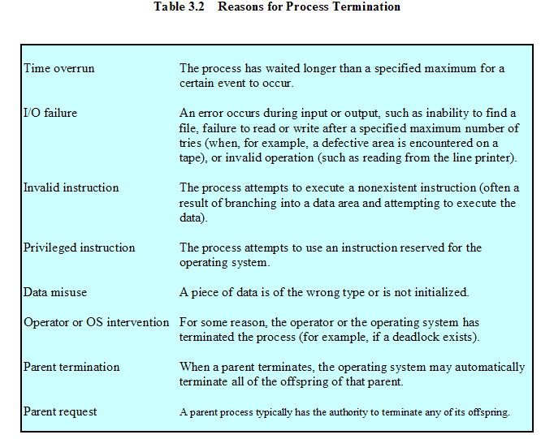
Process Termination
Notes:
TIME OVERRUN ，等候某个事件超时
intervention干涉，死锁
Offspring，后代

Slide 19
3.2 Process States
3.2.1 Trace of the Process
3.2.2 A Two-State Process Model
3.2.3 The Creation and Termination of Processes
3.2.4 A Five-State Model
3.2.5 Suspended Process

Slide 20
Limit of Two-State Process Model
Not-running
  ready to execute
  waiting for I/O (blocked)
Dispatcher cannot just select the process that has been in the queue the longest because it may be blocked
Notes:
分派器不能只考虑选择队列中最老的进程，相反，它应该扫描这个列表，查找那些未被阻塞且在队列中时间最长的进程。

Slide 21
A Five-State Model
Running(运行态)
Ready(就绪态)
Blocked(阻塞态)
New(新建态)
Exit(退出态)

Slide 22
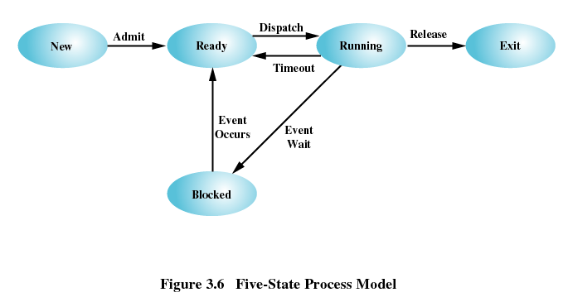
Five-State Process Model

Slide 23
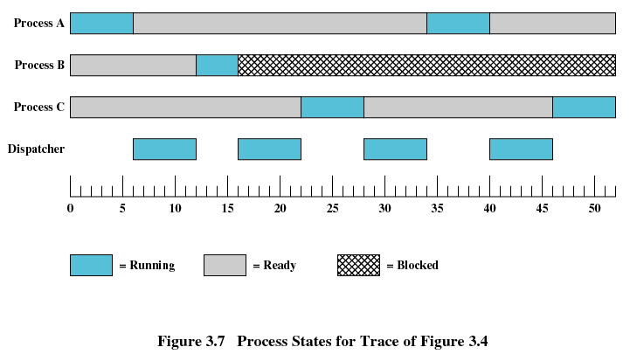
Process States

Slide 24
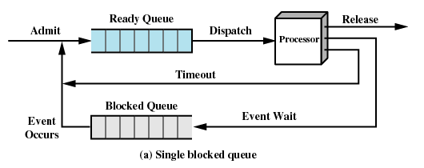
Using Two Queues

Slide 25
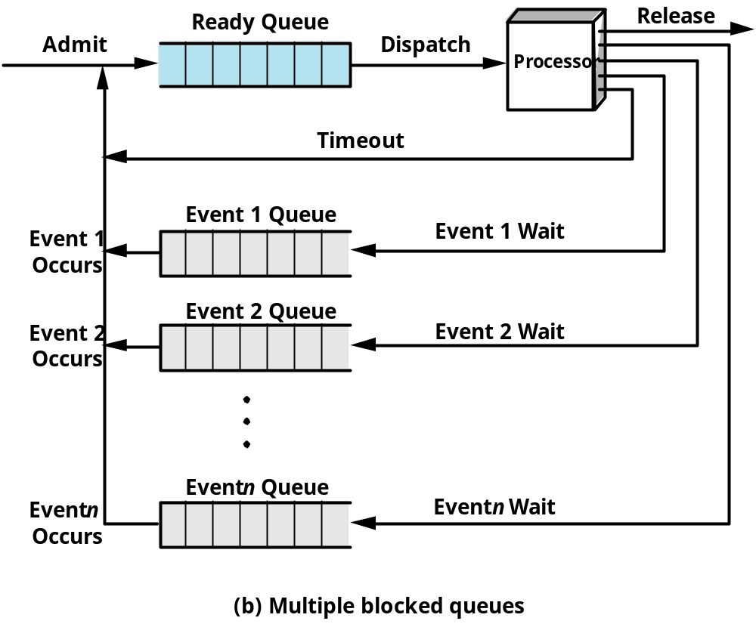
Multiple Blocked Queues

Slide 26
3.2 Process States
3.2.1 Trace of the Process
3.2.2 A Two-State Process Model
3.2.3 The Creation and Termination of Processes
3.2.4 A Five-State Model
3.2.5 Suspended Process

Slide 27
Suspended Processes(被挂起的进程)
Processor is faster than I/O so all processes could be waiting for I/O
Swap these processes to disk to free up more memory
Blocked state becomes suspend state when swapped to disk
Two new states
  Blocked/Suspend
  Ready/Suspend
Notes:
举例，餐馆，人没到齐，不安排桌子

Slide 28
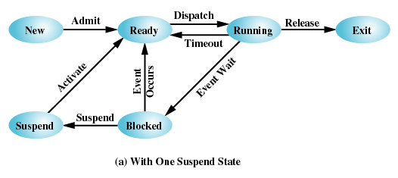
One Suspend State

Slide 29
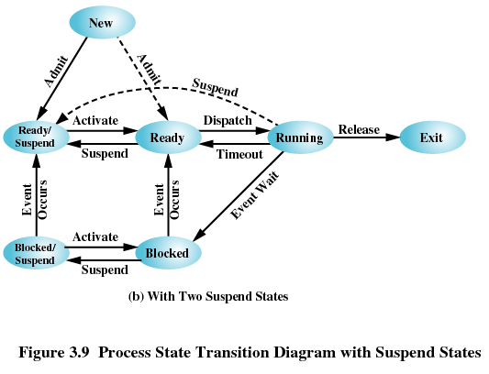
Two Suspend States

Slide 30
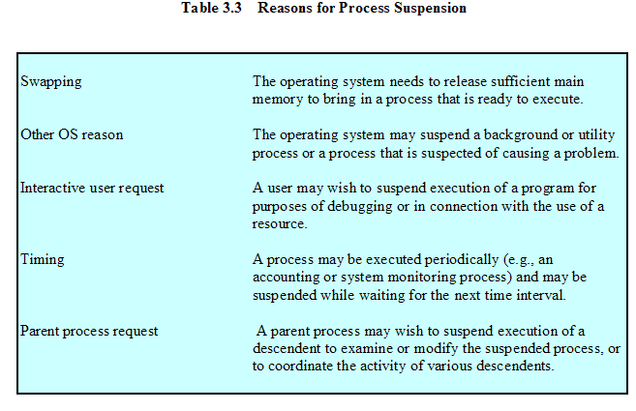
Reasons for Process Suspension

Slide 31
Agenda
3.1 What is a Process
3.2 Process States
3.3 Process Description
3.4 Process Control
3.5 Summary

Slide 32
3.3 Process Description
3.3.1 Processes and Resources
3.3.2 Operating System Control Structures
3.3.3 Process Control Structures

Slide 33
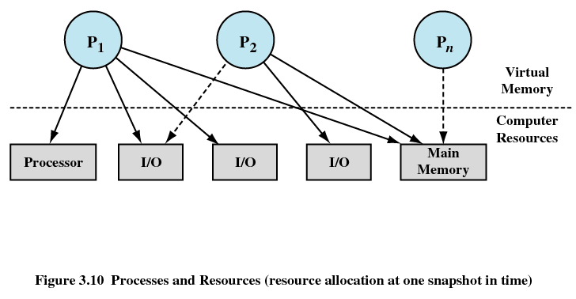
Processes and Resources

Slide 34
3.3 Process Description
3.3.1 Processes and Resources
3.3.2 Operating System Control Structures
3.3.3 Process Control Structures

Slide 35
Operating System Control Structures
Information about the current status of each process and resource (每个进程和资源的当前状态)
Tables are constructed for each entity the operating system manages (操作系统构造并维护他所管理的所有实体的信息表)

Slide 36
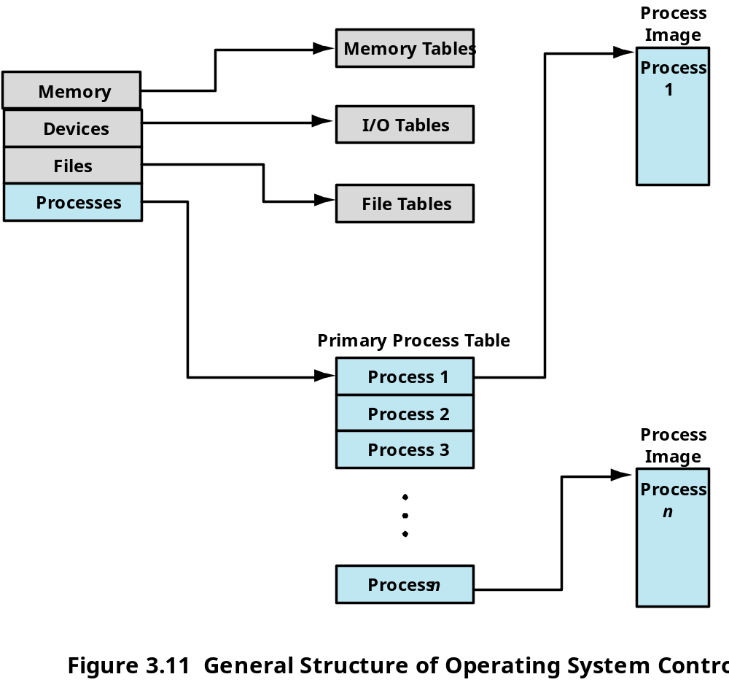
Structure of OS Control Tables

Slide 37
Memory Tables
Allocation of main memory to processes (分配给进程的主存)
Allocation of secondary memory to processes (分配给进程的辅存)
Protection attributes for access to shared memory regions(共享内存区域的保护属性)
Information needed to manage virtual memory(虚拟内存的管理信息)

Slide 38
I/O Tables
I/O device is available or assigned(分配状态)
Status of I/O operation
Location in main memory being used as the source or destination of the I/O transfer (数据传送的源和目的地址)

Slide 39
File Tables
Existence of files
Location on secondary memory
Current Status
Attributes

Slide 40
Process Table
Every entry is a description of a process image
Notes:
entry 登记

Slide 41
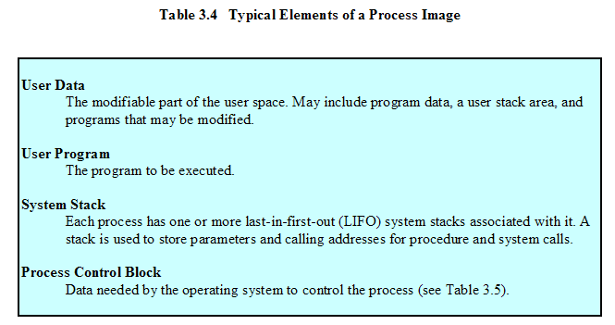
Process Image
Process Image
  Collection of program, data, stack, attributes

Slide 42
3.3 Process Description
3.3.1 Processes and Resources
3.3.2 Operating System Control Structures
3.3.3 Process Control Structures

Slide 43
Process Control Block
Process Identification
Processor State Information
  User-Visible Registers
  Control and Status Registers
  Stack Pointers
Process Control information
  Scheduling and State Information
  Data Structuring (link information)
  Interprocess Communication
  Process Privileges
  Memory Management
  Resource Ownership and Utilization
Notes:
Data Structuring进程可以以队列、环或者别的结构形式与其他进程进行链接。
Resource Ownership and Utilization,资源拥有和利用情况

Slide 44
Agenda
3.1 What is a Process
3.2 Process States
3.3 Process Description
3.4 Process Control
3.5 Summary

Slide 45
3.4 Process Control
3.4.1 Modes of Execution
3.4.2 Process Creation
3.4.3 Process Switching
3.4.4 Execution of the Operating System

Slide 46
Modes of Execution
User mode
  Less-privileged mode
  User programs typically execute in this mode
System mode, control mode, or kernel mode
  More-privileged mode
  Kernel of the operating system
Translation between the two model
  Processor status register (psr) and current privileged level (cpl)
  User mode->System mode
  System mode->User mode
Notes:
Certain instructions can only be executed in the more-privileged mode. These would include reading or altering a control register, such as the program status word; primitive I/O instructions; and instructions that relate to memory management. In addition, certain regions of memory can only be accessed in the more-privileged mode.
处理器状态寄存器(PSR )，包含2位的CPL(当前特权级别)域，级别0是最高特权级别，级别3是最低特权级别。大多数操作系统，如Linux，使用级别
0作为内核态，使用另一个级别作为用户态。

Slide 47
3.4 Process Control
3.4.1 Modes of Execution
3.4.2 Process Creation
3.4.3 Process Switching
3.4.4 Execution of the Operating System

Slide 48
Process Creation
Assign a unique process identifier
Allocate space for the process
Initialize process control block
Set up appropriate linkages
  Ex: add new process to linked list used for scheduling queue
Create of expand other data structures
  Ex: maintain an accounting file

Slide 49
3.4 Process Control
3.4.1 Modes of Execution
3.4.2 Process Creation
3.4.3 Process Switching
3.4.4 Execution of the Operating System

Slide 50
When to Switch a Process
A process switch may occur any time that the OS has gained control from the currently running process. The possible events that may give control to the OS include:
Interrupt
  Clock interrupt
    process has executed for the maximum allowable time slice
  I/O interrupt
  Memory fault
    Referenced virtual address is not in main memory, so it must be brought in.

Slide 51
When to Switch a Process
Trap
  error or exception occurred
  may cause process to be moved to Exit state
Supervisor call (System Call)
  such as file open

Slide 52
Process Switching
Save context of processor including program counter and other registers
Update the process control block of the process and change the process’s state that is currently in the Running state
Move process control block to appropriate queue – ready; blocked; ready/suspend
Select another process for execution

Slide 53
Process Switching
Update the process control block of the process selected and change it state
Update memory-management data structures
Restore context of the selected process

Slide 54
3.4 Process Control
3.4.1 Modes of Execution
3.4.2 Process Creation
3.4.3 Process Switching
3.4.4 Execution of the Operating System

Slide 55
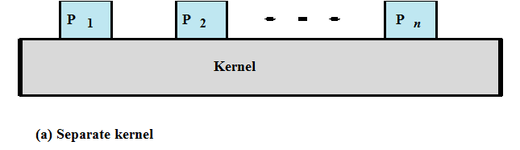
Execution of the Operating System
Non-process Kernel（无进程内核）
  Execute kernel outside of any process
  Operating system code is executed as a separate entity that operates in privileged mode

Slide 56
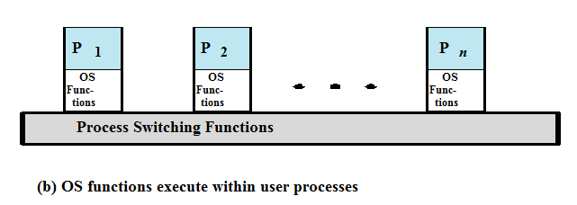
Execution of the Operating System
Execution Within User Processes(在用户进程中执行)
  Operating system software within context of a user process
  Process executes in privileged mode when executing operating system code

Slide 57
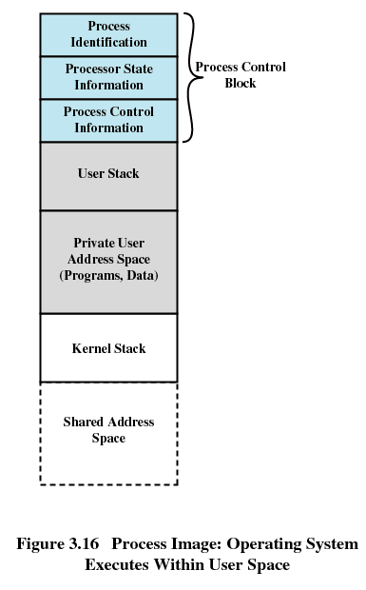

Slide 58
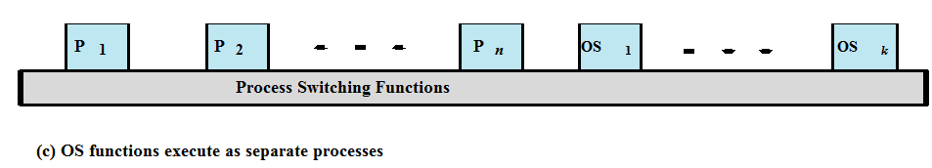
Execution of the Operating System
Process-Based Operating System（基于进程的OS）
  Implement operating system as a collection of system processes
  Useful in multi-processor or multi-computer environment

Slide 59
Agenda
3.1 What is a Process
3.2 Process States
3.3 Process Description
3.4 Process Control
3.5 Summary

